Slide 1
My Shape and Angles
Interactive Notebook
Name
Class
Term 3 Semester 2

Slide 2
Contents
Formula Page
Page
Date
Description
2
3

Slide 3
Tasks
24
7
30
Essential Question
Questions
Notes
Summary
6
7

Slide 4
Geogebra parallel lines

Slide 5
24
7
30
Date
Angles in Parallel Lines
Describe the relationship between the angles when a transversal cuts a pair of parallel lines
7

Slide 6
24
7
30
Date
Angles in Parallel Lines
Describe the relationship between the angles when a transversal cuts a pair of parallel lines
Parallel lines – Same distance apart and do not touch
7

Slide 7
24
7
30
Date
Angles in Parallel Lines
Describe the relationship between the angles when a transversal cuts a pair of parallel lines
Parallel lines – Same distance apart and do not touch
The transversal line cuts the parallel lines
7

Slide 8
24
7
30
Date
Angles in Parallel Lines
Describe the relationship between the angles when a transversal cuts a pair of parallel lines
Parallel lines – Same distance apart and do not touch
The transversal line cuts the parallel lines
Alternate angles are equal (Z)
7

Slide 9
24
7
30
Date
Angles in Parallel Lines
Describe the relationship between the angles when a transversal cuts a pair of parallel lines
Alternate angles are equal ( Z )
Corresponding angles are equal ( F )

Slide 10
24
7
30
Date
Angles in Parallel Lines
Describe the relationship between the angles when a transversal cuts a pair of parallel lines
Corresponding angles are equal ( F )
Co-interior angles are supplementary (add to 180$°$) C

Slide 11
Fill in the questions

Slide 12
24
7
30
Date
Angles in Parallel Lines
Describe the relationship between the angles when a transversal cuts a pair of parallel lines
What are parallel lines?
Parallel lines – Same distance apart and do not touch
The transversal line cuts the parallel lines
Alternate angles are equal
7

Slide 13
24
7
30
Date
Angles in Parallel Lines
Describe the relationship between the angles when a transversal cuts a pair of parallel lines
What are parallel lines?
Parallel lines – Same distance apart and do not touch
What is a transversal?
The transversal line cuts the parallel lines
Alternate angles are equal
7

Slide 14
24
7
30
Date
Angles in Parallel Lines
Describe the relationship between the angles when a transversal cuts a pair of parallel lines
What are parallel lines?
Parallel lines – Same distance apart and do not touch
What is a transversal?
The transversal line cuts the parallel lines
Alternate angles are equal
What are the angle relationships associated with parallel lines?
7

Slide 15
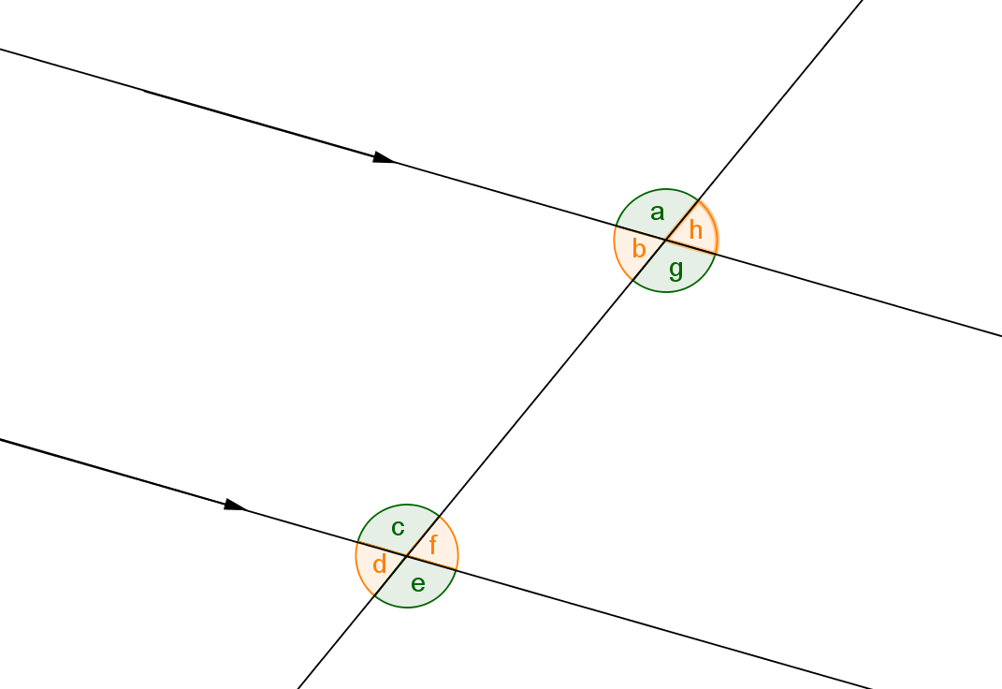
Task One – For the diagram below write down the pairs of angles that are - a) Corresponding b) Alternate c) Co–interior d) Vertically opposite e) Supplementary

Slide 16
Task One – For the diagram below write down the pairs of angles that are - a) Corresponding (a and c, b and d, g and e, h and f) b) Alternate c) Co–interior d) Vertically opposite e) Supplementary

Slide 17
Task One – For the diagram below write down the pairs of angles that are - a) Corresponding (a and c, b and d, g and e, h and f) b) Alternate ( b and f , c and g) c) Co–interior d) Vertically opposite e) Supplementary

Slide 18
Task One – For the diagram below write down the pairs of angles that are - a) Corresponding (a and c, b and d, g and e, h and f) b) Alternate ( b and f , c and g) c) Co–interior (b and c, f and g) d) Vertically opposite e) Supplementary

Slide 19
Task One – For the diagram below write down the pairs of angles that are - a) Corresponding (a and c, b and d, g and e, h and f) b) Alternate ( b and f , c and g) c) Co–interior (b and c, f and g) d) Vertically opposite (a and g, b and h, c and e, d and f) e) Supplementary

Slide 20
Task One – For the diagram below write down the pairs of angles that are - a) Corresponding (a and c, b and d, g and e, h and f) b) Alternate ( b and f , c and g) c) Co–interior (b and c, f and g) d) Vertically opposite (a and g, b and h, c and e, d and f) e) Supplementary
(and adjacent angles eg a and b, a and h)

Slide 21
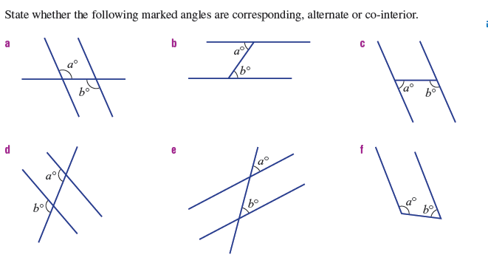
Task Two

Slide 22
Task Two
Alternate
Alternate
Co-interior
Co-interior
Corresponding
Corresponding

Slide 23
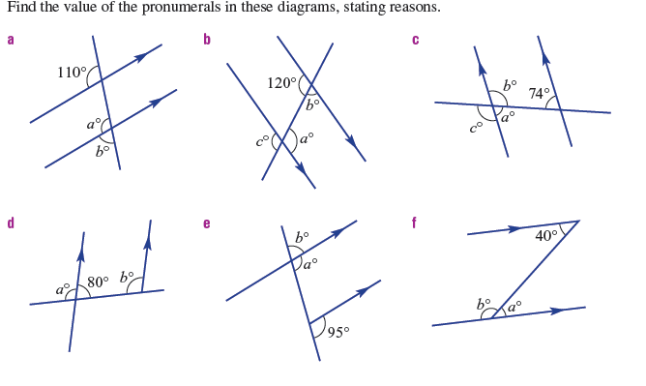
Task 3
Textbook Page 58/59

Slide 24
Task 3
Textbook Page 58/59
a = 110$°$

Slide 25
Task 3
Textbook Page 58/59
a = 110$°$ (Corresponding to 110$°$)

Slide 26

Task 3
Textbook Page 58/59
a = 110$°$ (Corresponding to 110$°$)
b = 70$°$

Slide 27

Task 3
Textbook Page 58/59
a = 110$°$ (Corresponding to 110$°$)
b = 70$°$ (supplemantary to a)

Slide 28
Task 3
Textbook Page 58/59

Slide 29
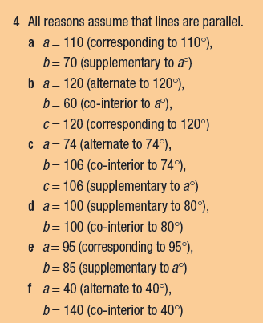
Answers

Slide 30
Notes Review
24, 7 ,30
Date
Title
Essential question
Notes complete
Notes complete with colour and diagrams
Questions completed
Contents page filed in
Formula page filled in

Slide 31
Homework
Review your notes and write a summary answering the essential question.

